Slide 1
Kubernetes in Action
Part X
2023.04.04
Suho Kwon
(suho.kwon@gmail.com, http://blog.naver.com/knix008)

Slide 2
Extending Kubernetes

Slide 3
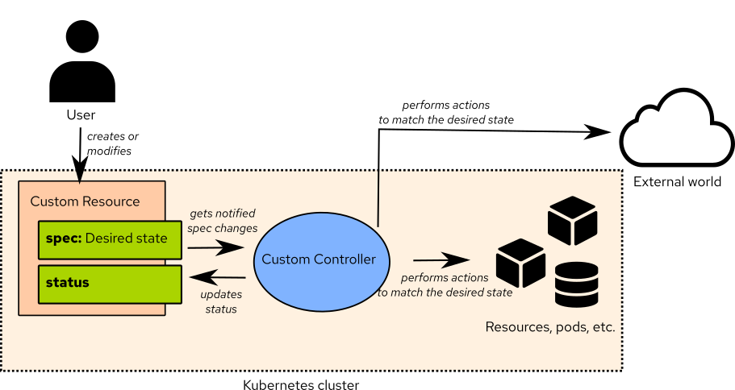
Defining Custom API Objects(1/)
A Custom Controller :
  You’ve learned about the API objects that Kubernetes provides and how they’re used to build application systems. Currently, Kubernetes users mostly use only these objects even though they represent relatively low-level, generic concepts.
  As the Kubernetes ecosystem evolves, you’ll see more and more high-level objects, which will be much more specialized than the resources Kubernetes supports today. Instead of dealing with Deployments, Services, ConfigMaps, and the like, you’ll create and manage objects that represent whole applications or software services. A custom controller will observe those high-level objects and create low-level objects based on them. For example, to run a messaging broker inside a Kubernetes cluster, all you’ll need to do is create an instance of a “Queue” resource and all the necessary Secrets, Deployments, and Services will be created by a custom Queue controller. Kubernetes already provides ways of adding custom resources like this.

Slide 4
Defining Custom API Objects(2/)
Introducing CustomResourceDefinitions :
  To define a new resource type, all you need to do is post a “CustomResourceDefinition object (CRD)” to the Kubernetes API server. The “CustomResourceDefinition” object is the description of the custom resource type. Once the CRD is posted, users can then create instances of the custom resource by posting JSON or YAML manifests to the API server, the same as with any other Kubernetes resource.
  NOTE : Prior to Kubernetes 1.7, custom resources were defined through “ThirdPartyResource” objects, which were similar to CustomResourceDefinitions, but were removed in version 1.8.
  Creating a CRD so that users can create objects of the new type isn’t a useful feature if those objects don’t make something tangible happen in the cluster. Each CRD will usually also have an associated controller (an active component doing something based on the custom objects), the same way that all the core Kubernetes resources have an associated controller. For this reason, to properly show what “CustomResourceDefinitions” allow you to do other than adding instances of a custom object, a controller must be deployed as well.

Slide 5
Defining Custom API Objects(3/)
Introducing the Example CustomResourceDefinition :
  Let’s imagine you want to allow users of your Kubernetes cluster to run static websites as easily as possible, without having to deal with Pods, Services, and other Kubernetes resources. What you want to achieve is for users to create objects of type Website that contain nothing more than the website’s name and the source from which the website’s files (HTML, CSS, PNG, and others) should be obtained. You’ll use a Git repository as the source of those files. When a user creates an instance of the Website resource, you want Kubernetes to spin up a new web server pod and expose it through a Service, as shown in the following figure.
  To create the Website resource, you want users to post manifests along the lines of the one shown in the following listing.
kind: Website
metadata:
name: kubia
spec:
gitRepo: https://github.com/knix008/Website-Example.git

Slide 6
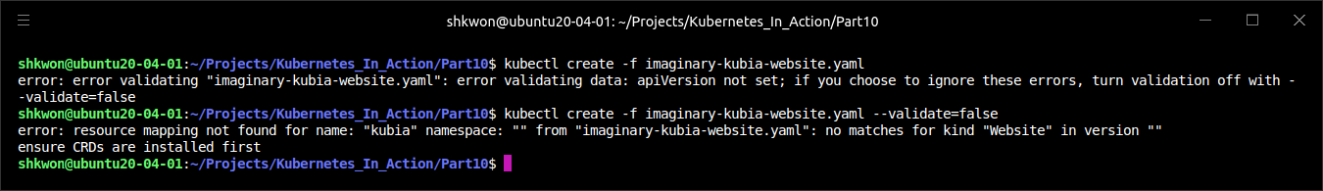
Defining Custom API Objects(4/)
Introducing the Example CustomResourceDefinition :
  Like all other resources, your resource contains a “kind” and a “metadata.name” field, and like most resources, it also contains a “spec” section. It contains a single field called “gitRepo” (you can choose the name)—it specifies the Git repository containing the website’s files. You’ll also need to include an “apiVersion” field, but you don’t know yet what its value must be for custom resources.
  If you try posting this resource to Kubernetes, you’ll receive an error because Kubernetes doesn’t know what a “Website” object is yet :
  Before you can create instances of your custom object, you need to make Kubernetes recognize them.
$ kubectl create -f imaginary-kubia-website.yaml

Slide 7
Defining Custom API Objects(5/)
Creating a CustomResourceDefinition Object :
  To make Kubernetes accept your custom “Website” resource instances, you need to post the “CustomResourceDefinition” shown in the following listing to the API server.
apiVersion: apiextensions.k8s.io/v1
kind: CustomResourceDefinition
metadata:
name: websites.extensions.example.com
spec:
scope: Namespaced
group: extensions.example.com
versions:
- name: v1
served: true
storage: true
schema:
openAPIV3Schema:
type: object
properties:
spec:
type: object
properties:
cronSpec:
type: string
image:
type: string
replicas:
type: integer
gitRepo:
type: string
names:
kind: Website
singular: website
plural: websites
website-crd.yaml

Slide 8
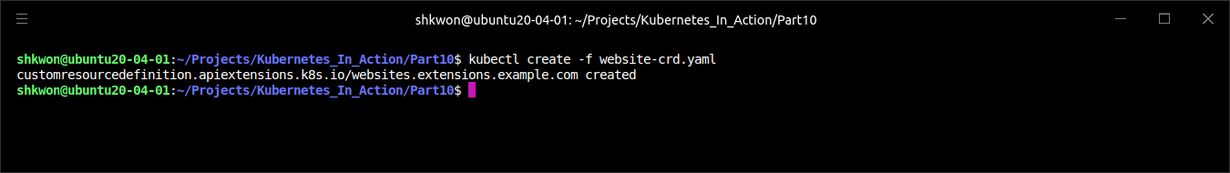
Defining Custom API Objects(6/)
Creating a CustomResourceDefinition Object :
  After you post the descriptor to Kubernetes, it will allow you to create any number of instances of the custom “Website” resource.
  You can create the CRD from the “website-crd.yaml” file available in the code archive :
  NOTE : For more information, see https://kubernetes.io/docs/tasks/extend-kubernetes/custom-resources/custom-resource-definitions/.

Slide 9
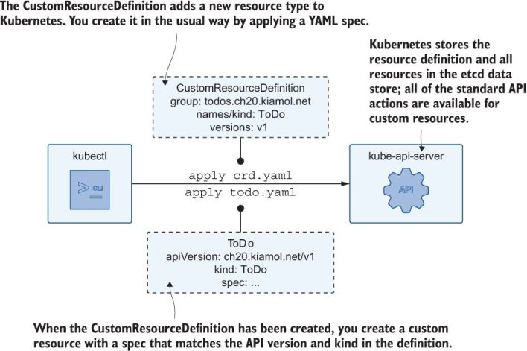
Defining Custom API Objects(7/)
Creating a CustomResourceDefinition Object :
  You’re wondering about the long name of the CRD. Why not call it “Website”? The reason is to prevent name clashes. By adding a suffix to the name of the CRD (which will usually include the name of the organization that created the CRD), you keep CRD names unique. Luckily, the long name doesn’t mean you’ll need to create your “Website” resources with “kind: websites.extensions.example.com”, but as “kind: Website”, as specified in the “names.kind” property of the CRD. The “extensions.example.com” part is the API group of your resource.
  You’ve seen how creating Deployment objects requires you to set “apiVersion” to “apps/v1” instead of “v1”. The part before the slash is the API group (Deployments belong to the apps API group), and the part after it is the version name (“v1” in the case of Deployments). When creating instances of the custom “Website” resource, the “apiVersion” property will need to be set to “extensions.example.com/v1”.

Slide 10
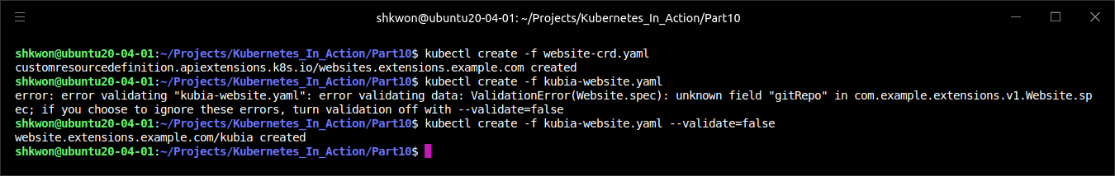
Defining Custom API Objects(8/)
Creating an Instance of a Custom Resource :
  Considering what you learned, you’ll now create a proper YAML for your “Website” resource instance. The YAML manifest is shown in the following listing.
  The “kind” of your resource is “Website”, and the “apiVersion” is composed of the “API group” and the “version number” you defined in the “CustomResourceDefinition”. Create your “Website” object now :
  NOTE : The response tells you that the “API server” has accepted and stored your custom “Website” object.
apiVersion: extensions.example.com/v1
kind: Website
metadata:
name: kubia
spec:
gitRepo: https://github.com/knix008/Website-Example.git
kubia-website.yaml
$ kubectl create -f kubia-website.yaml

Slide 11
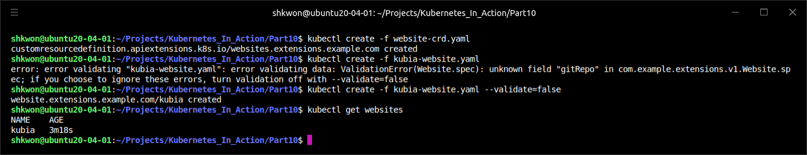
Defining Custom API Objects(9/)
Retrieving Instances of a Custom Resource :
  List all the “websites” in your cluster :
$ kubectl get websites

Slide 12
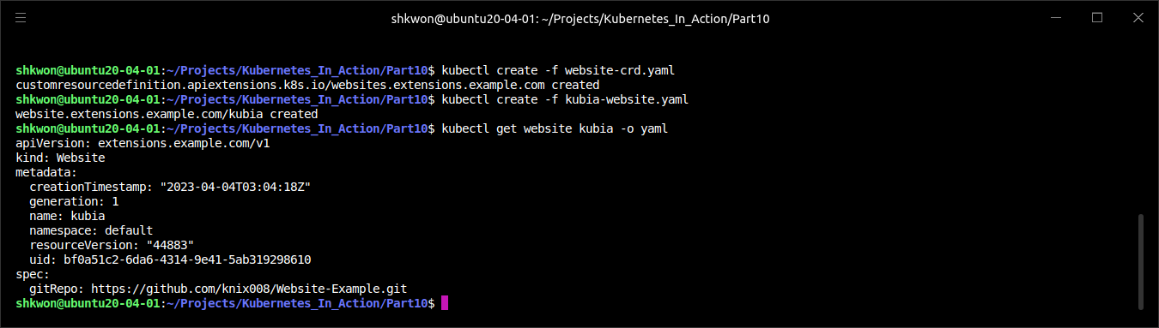
Defining Custom API Objects(10/)
Retrieving Instances of a Custom Resource :
  As with existing Kubernetes resources, you can create and then list instances of custom resources. You can also use “$ kubectl describe” command to see the details of your custom object, or retrieve the whole YAML with “$ kubectl get” command, as in the following listing.
  Note : The resource includes everything that was in the original YAML definition, and that Kubernetes has initialized additional metadata fields the way it does with all other resources.

Slide 13
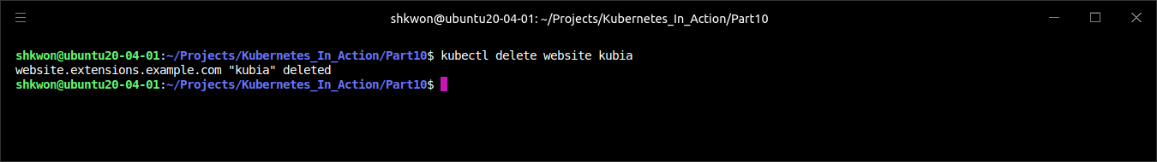
Defining Custom API Objects(11/)
Deleting an Instance of a Custom Object :
  Obviously, in addition to creating and retrieving custom object instances, you can also delete them :
  NOTE : You’re deleting an instance of a Website, not the Website CRD resource. You could also delete the CRD object itself, but let’s hold off on that for a while, because you’ll be creating additional Website instances later.
$ kubectl delete website kubia

Slide 14
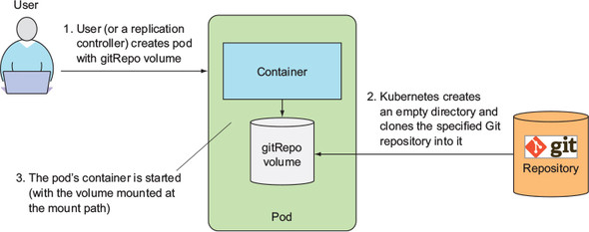
Defining Custom API Objects(12/)
Deleting an Instance of a Custom Object :
  By creating a “CustomResourceDefinition” object, you can now store, retrieve, and delete custom objects through the Kubernetes API server. These objects don’t do anything yet. You’ll need to create a controller to make them do something.
  In general, the point of creating custom objects like this isn’t always to make something happen when the object is created. Certain custom objects are used to store data instead of using a more generic mechanism such as a “ConfigMap”. Applications running inside pods can query the API server for those objects and read whatever is stored in them.
  But in this case, we said you wanted the existence of a “Website” object to result in the spinning up of a web server serving the contents of the “Git repository” referenced in the object.

Slide 15
Defining Custom API Objects(13/)
Automating Custom Resources with Custom Controllers :
  To make your ”Website objects” run a web server pod exposed through a “Service”, you’ll need to build and deploy a “Website controller”, which will watch the API server for the creation of “Website objects” and then create the “Service” and the “web server Pod” for each of them.
  To make sure the Pod is managed and survives node failures, the controller will create a “Deployment” resource instead of an unmanaged Pod directly. The controller’s operation is summarized in the following figure.

Slide 16
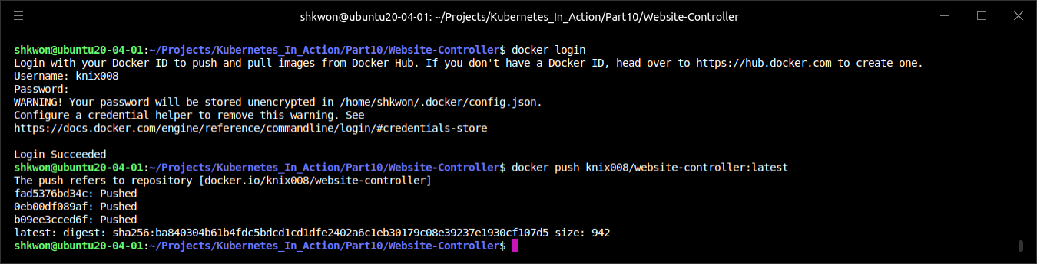
Defining Custom API Objects(14/)
Automating Custom Resources with Custom Controllers :
  The simple initial version of the controller works well enough to show CRDs and the controller in action, but it’s far from being production-ready, because it’s overly simplified. The container image is available at “hub.docker.com/knix008/website-controller:latest”, and the source code is at “https://github.com/knix008/Kubernetes_In_Action/Part10/Website-Controller”.
  NOTICE : Before you run “$ make” command in the project directory, be sure that your Go compiler is installed after deleting previous version of Go compiler completely.
  To build binary and docker image, just run “$ make image” command in the project directory. After that, you need to login “docker hub”. Then, run “docker push” command.

Slide 17
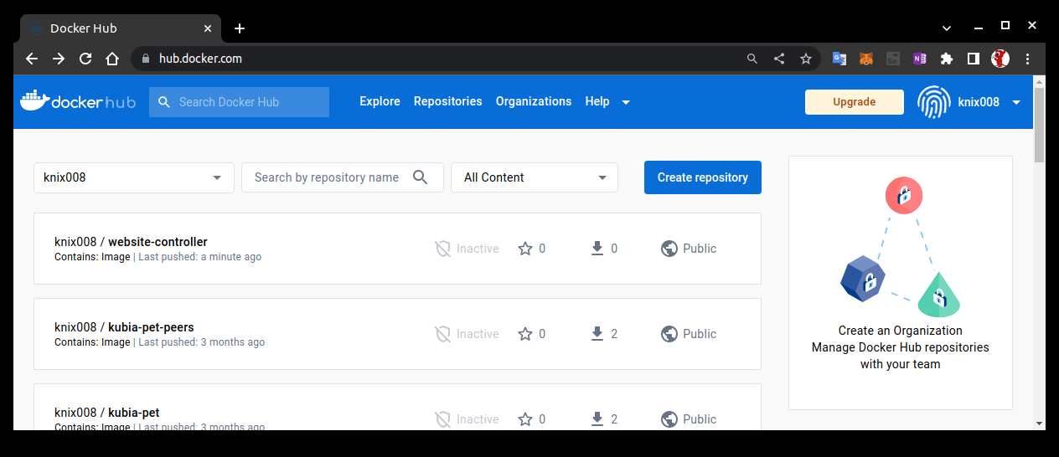
NOTE : The Docker Hub
Website Controller Registration :
  After finishing the previous step, you can check your docker image in your docker hub repository like the following screenshot.

Slide 18
Defining Custom API Objects(15/)
Understanding What the Website Controller Does :
  Immediately upon startup, the controller starts to watch “Website objects” by requesting the following URL :
  You may recognize the “hostname” and “port”—the controller isn’t connecting to the “API server” directly, but is instead connecting to the “kubectl proxy” process, which runs in a “sidecar container” in the same pod and acts as the “ambassador” to the “API server” (we examined the “ambassador pattern”). The proxy forwards the request to the API server, taking care of both “TLS encryption and authentication” (see the following figure).
http://localhost:8001/apis/extensions.example.com/v1/websites?watch=true

Slide 19
Defining Custom API Objects(16/)
Understanding What the Website Controller Does :
  Through the connection opened by this “HTTP GET request”, the API server will send watch events for every change to any “Website” object.
  The API server sends the “ADDED” watch event every time a new Website object is created. When the controller receives such an event, it extracts the “Website’s name” and “the URL of the Git repository” from “the Website object” it received in the watch event and creates a “Deployment” and a “Service” object by posting their JSON manifests to the API server.
  The Deployment resource contains a template for a pod with two containers (shown in the following figure) : one running an “nginx” server and another one running a “gitsync” process, which keeps a local directory synced with the contents of a Git repo. The local directory is shared with the nginx container through an “emptyDir” volume (you did something similar, but instead of keeping the local directory synced with a Git repo, you used a “gitRepo volume” to download the Git repo’s contents at pod startup; the volume’s contents weren’t kept in sync with the Git repo afterward). The Service is a “NodePort” Service, which exposes your web server pod through a random port on each node (the same port is used on all nodes). When a pod is created by the Deployment object, clients can access the website through the node port.

Slide 20
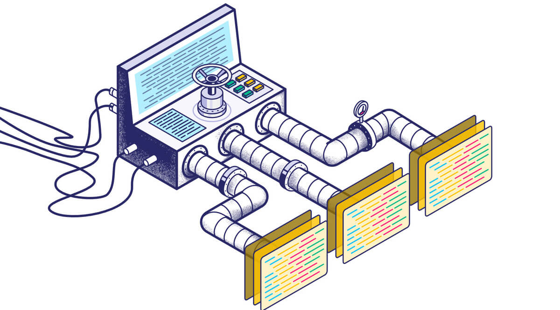
Defining Custom API Objects(17/)
Understanding What the Website Controller Does :
  The API server also sends a “DELETED” watch event when a “Website” resource instance is deleted. Upon receiving the event, the controller deletes the Deployment and the Service resources it created earlier. As soon as a user deletes the “Website” instance, the controller will shut down and remove the web server serving that website.
  NOTE : The oversimplified controller isn’t implemented properly. The way it watches the API objects doesn’t guarantee it won’t miss individual watch events. The proper way to watch objects through the API server is to not only watch them, but also periodically re-list all objects in case any watch events were missed.

Slide 21
Defining Custom API Objects(18/)
Running the Controller as a Pod :
  During development, you can the controller on your local development laptop and use a locally running “kubectl proxy” process (not running as a pod) as the ambassador to the Kubernetes API server. This allows you to develop quickly, because you don’t need to build a container image after every change to the source code and then run it inside Kubernetes.
  When you are ready to deploy the controller into production, the best way is to run the controller inside Kubernetes itself, the way you do with all the other core controllers. To run the controller in Kubernetes, you can deploy it through a “Deployment” resource. The following listing shows an example of such a Deployment.
apiVersion: apps/v1
kind: Deployment
metadata:
name: website-controller
spec:
replicas: 1
template:
metadata:
name: website-controller
labels:
app: website-controller
spec:
serviceAccountName: website-controller
containers:
- name: main
image: knix008/website-controller
- name: proxy
image: knix008/kubectl-proxy:latest
website-controller.yaml

Slide 22
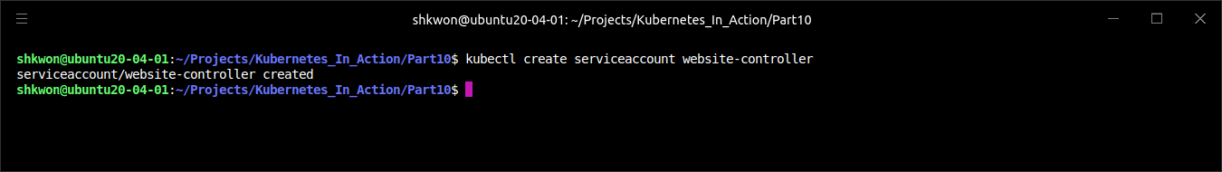
Defining Custom API Objects(19/)
Running the Controller as a Pod :
  As you can see, the Deployment deploys a single replica of a two-container pod. One container runs your controller, whereas the other one is the “ambassador” container used for simpler communication with the API server. The pod runs under its own special “ServiceAccount”, so you’ll need to create it before you deploy the controller :
$ kubectl create serviceaccount website-controller

Slide 23
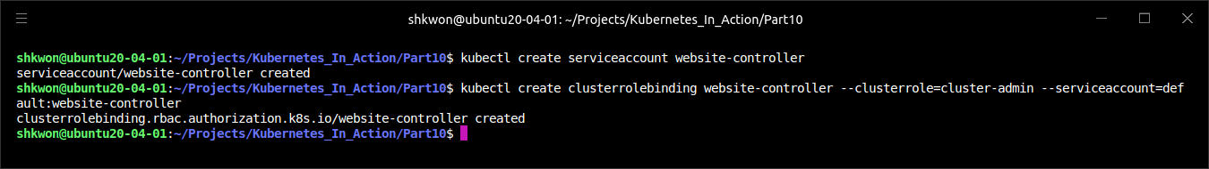
Defining Custom API Objects(20/)
Running the Controller as a Pod :
  If “Role Based Access Control (RBAC)” is enabled in your cluster, Kubernetes will not allow the controller to watch Website resources or create Deployments or Services. To allow it to do that, you’ll need to bind the “website-controller” ServiceAccount to the cluster-admin “ClusterRole”, by creating a “ClusterRoleBinding” like this :
  Once you have the “ServiceAccount” and “ClusterRoleBinding” in place, you can deploy the controller’s Deployment.
$ kubectl create clusterrolebinding website-controller --clusterrole=cluster-admin --serviceaccount=default:website-controller

Slide 24
Defining Custom API Objects(21/)
Seeing the Controller in Action :
  With the controller now running, create the “kubia Website resource” again :

Slide 25
>
:
  .

Slide 26
>
:
  .

Slide 27
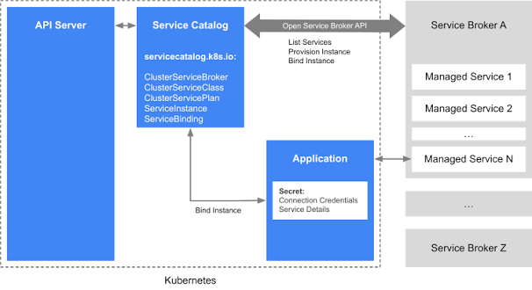
Extending Kubernetes with the Kubernetes Service Catalog(1/)
Service Catalog :
  One of the first additional API servers that will be added to Kubernetes through API server aggregation is the Service Catalog API server.
  Currently, for a pod to consume a service, someone needs to deploy the pods providing the service, a Service resource, and possibly a Secret so the client pod can use it to authenticate with the service. That someone is usually the same user deploying the client pod or, if a team is dedicated to deploying these types of general services, the user needs to file a ticket and wait for the team to provision the service. This means the user needs to either create the manifests for all the components of the service, know where to find an existing set of manifests, know how to configure it properly, and deploy it manually, or wait for the other team to do it.
  Kubernetes is supposed to be an easy-to-use, self-service system. Ideally, users whose apps require a certain service (for example, a web application requiring a backend database), should be able to say to Kubernetes. “Hey, I need a PostgreSQL database. Please provision one and tell me where and how I can connect to it.” This will soon be possible through the Kubernetes Service Catalog.

Slide 28
Extending Kubernetes with the Kubernetes Service Catalog(2/)
Introducing the Service Catalog :
  The Service Catalog is a catalog of services. Users can browse through the catalog and provision instances of the services listed in the catalog by themselves without having to deal with Pods, Services, ConfigMaps, and other resources required for the service to run.
  Instead of adding custom resources to the API server for each type of service, the Service Catalog introduces the following four generic API resources :
    A ClusterServiceBroker, which describes an (external) system that can provision services
    A ClusterServiceClass, which describes a type of service that can be provisioned
    A ServiceInstance, which is one instance of a service that has been provisioned
    A ServiceBinding, which represents a binding between a set of clients (pods) and a ServiceInstance

Slide 29
Extending Kubernetes with the Kubernetes Service Catalog(3/)
Introducing the Service Catalog :
  A cluster admin creates a ClusterServiceBroker resource for each service broker whose services they’d like to make available in the cluster. Kubernetes then asks the broker for a list of services that it can provide and creates a ClusterServiceClass resource for each of them. When a user requires a service to be provisioned, they create an ServiceInstance resource and the a ServiceBinding to bind that ServiceInstance to their pods. Those pods are then injected with a Secret that holds all the necessary credentials and other data required to connect to the provisioned ServiceInstance.

Slide 30
Extending Kubernetes with the Kubernetes Service Catalog(4/)
Introducing the Service Catalog API server and Controller Manager :
  Similar to core Kubernetes, the Service Catalog is a distributed system composed of three components:
    Service Catalog API Server
    etcd as the storage
    Controller Manager, where all the controllers run
  The four Service Catalog–related resources we introduced earlier are created by posting YAML/JSON manifests to the API server. It then stores them into its own etcd instance or uses CustomResourceDefinitions in the main API server as an alternative storage mechanism (in that case, no additional etcd instance is required).
  The controllers running in the Controller Manager are the ones doing something with those resources. They obviously talk to the Service Catalog API server, the way other core Kubernetes controllers talk to the core API server. Those controllers don’t provision the requested services themselves. They leave that up to external service brokers, which are registered by creating ServiceBroker resources in the Service Catalog API.

Slide 31
>
:
  .

Slide 32
>
:
  .

Slide 33
>
:
  .

Slide 34
Building Multi-Node Cluster

Slide 35
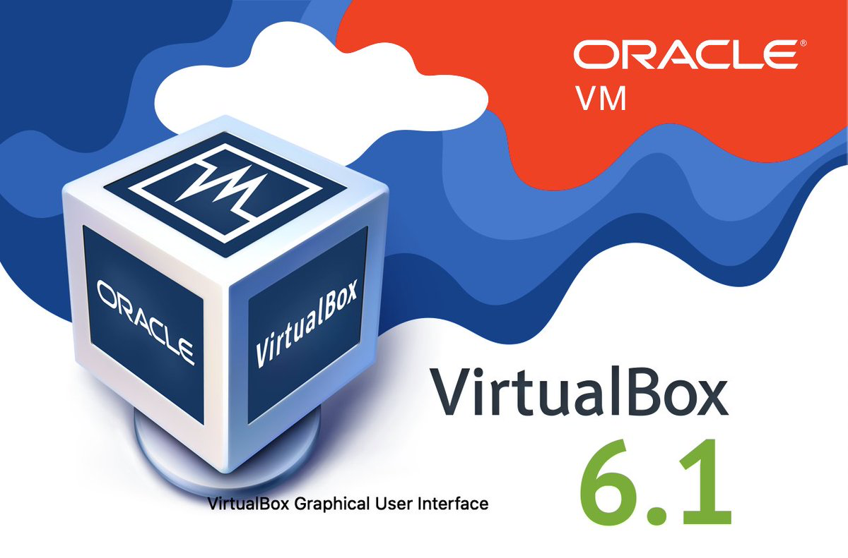
Operating System Requirements
VirtualBox :
  First, you need to download and install VirtualBox, if you don’t have it installed already. You can download it from https://www.virtualbox.org/wiki/Downloads.
  Once you have it running, download the Ubuntu 20.04 or Ubuntu 22.04(2023.04) ISO image from https://ubuntu.com/download/desktop/thank-you?version=22.04.2&architecture=amd64. You can also use a different Linux distribution, but make sure it’s supported by checking the https://kubernetes.io/docs/tasks/tools/ website.
  NOTE : For Apple M1, VirtualBox technical preview version is available now(2023.04). VMWare 7.x Beta version is also available.

Slide 36
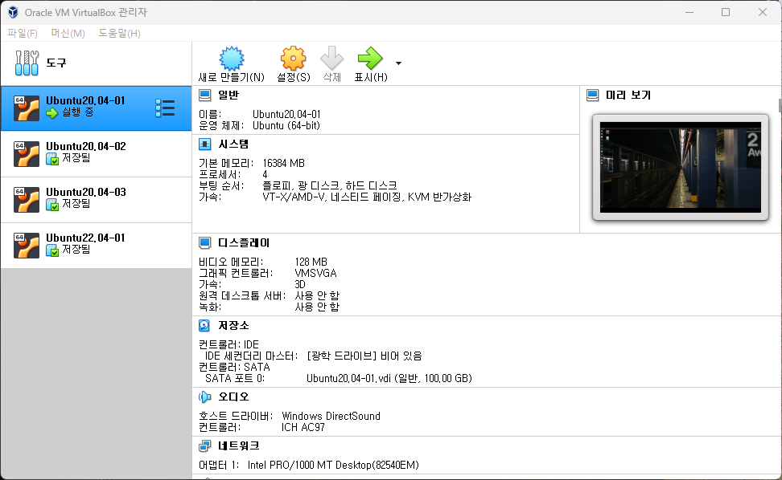
Creating Virtual Machine
Virtual Machine Setting :
  Next, you’ll create the VM for your Kubernetes master. Start by clicking the New icon in the upper-left corner. Then enter “VirtualBox Image Name” as the name, and select Linux as the Type and 64-bit.
  After clicking the Next button, you can set the VM’s memory size and set up the hard disk. If you have enough memory, select at least 2GB (keep in mind you’ll run three such VMs, 16GB is preferrable, 4 CPU : 2 Physical, 2 Hyper Thread in each CPU). When creating the hard disk, leave the default options selected(But, 100GB is preferrable).
  Here’s what they were in my case :
    Hard disk file type: VDI (VirtualBox Disk Image)
    Storage on physical hard disk : Dynamically allocated
    File system size: Ubuntu20.04-01, Ubuntu20.04-02, Ubuntu20.04-03, etc., size 100GB SSD

Slide 37
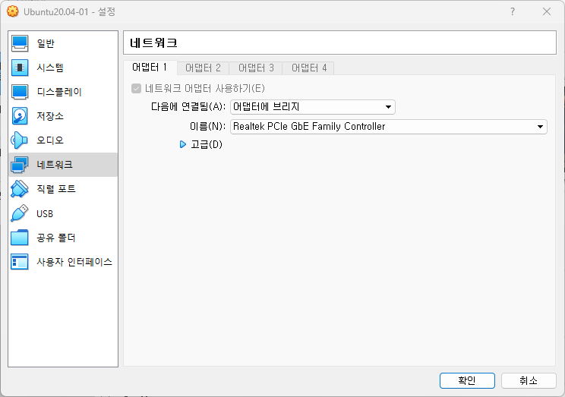
Configuring the Network Adapter for the VM
Adapter Bridge :
  Once you’re done creating the VM, you need to configure its network adapter, because the default won’t allow you to run multiple nodes properly. You’ll configure the adapter so it uses the “Bridged Adapter” mode. This will connect your VMs to the same network your host computer is in. Each VM will get its own IP address, the same way as if it were a physical machine connected to the same switch your host computer is connected to. Other options are much more complicated, because they usually require two network adapters to be set up.
  To configure the network adapter, make sure the VM is selected in the main VirtualBox window and then click the Settings icon (next to the New icon you clicked before).
  A window like the one shown in the following figure will appear. On the left-hand side, select Network and then, in the main panel on the right, select “Attached to: Bridged Adapter”, as shown in the figure. In the Name drop-down menu, select your host machine’s adapter, which you use to connect your machine to the network.

Slide 38
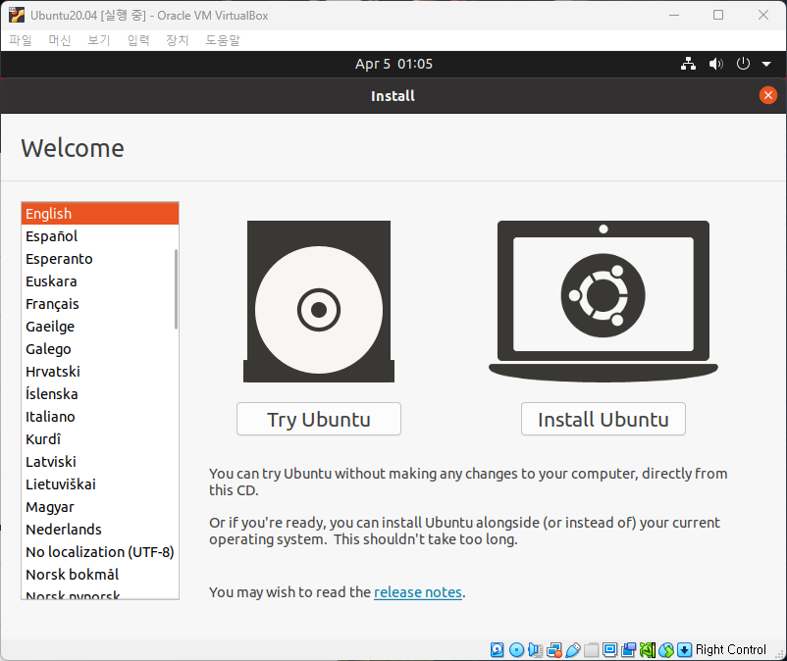
Installing the Operating System
Setting up Operating System :
  You’re now ready to run the VM and install the operating system. Ensure the VM is still selected in the list and click on the Start icon at the top of the VirtualBox main window.
  NOTICE : Sometimes, when you try to install Ubuntu 2x.04 version on VirtualBox with “Adapter Bridge” networking mode, VM will crash. In this case, change the networking mode to “NAT”. Then try again. After the installation of the OS, you can chance the “NAT” to “Adapter Bridge” networking mode.

Slide 39
Installing Docker and Kubernetes
Docker, Kubelet, Kubeadm, Kubectl :
  Please refer to https://docs.docker.com/engine/install/ubuntu/ for Docker installation on Ubuntu.
  NOTICE : Don’t forget the “Post-Installation” on Ubuntu.
  To install Kubernetes, please refer to https://kubernetes.io/docs/setup/production-environment/tools/kubeadm/install-kubeadm/#installing-kubeadm-kubelet-and-kubectl.
  NOTICE : You need to disable “Swapping” in order for the Kubelet to work properly.

Slide 40
>
:
  .

Slide 41
>
:
  .

Slide 42
>
:
  .

Slide 43
>
:
  .

Slide 44
>
:
  .

Slide 45
>
:
  .

Slide 46
>
:
  .

Slide 47
>
:
  .

Slide 48
>
:
  .

Slide 49
>
:
  .

Slide 50
>
:
  .

Slide 51
>
:
  .

Slide 52
>
:
  .

Slide 53
>
:
  .

Slide 54
>
:
  .

Slide 55
>
:
  .

Slide 56
>
:
  .

Slide 57
>
:
  .

Slide 58
>
:
  .

Slide 59
>
:
  .

Slide 60
>
:
  .

Slide 61
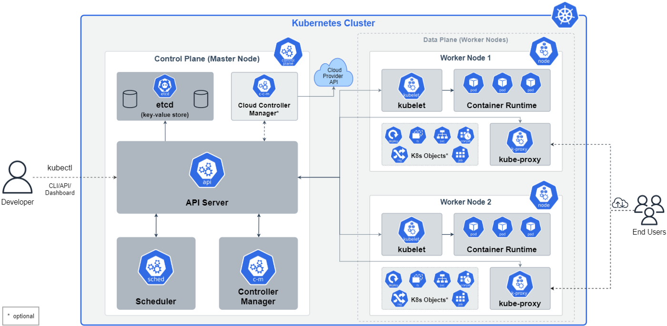
NOTE : Big Picture - The Kubernetes Cluster

Slide 62
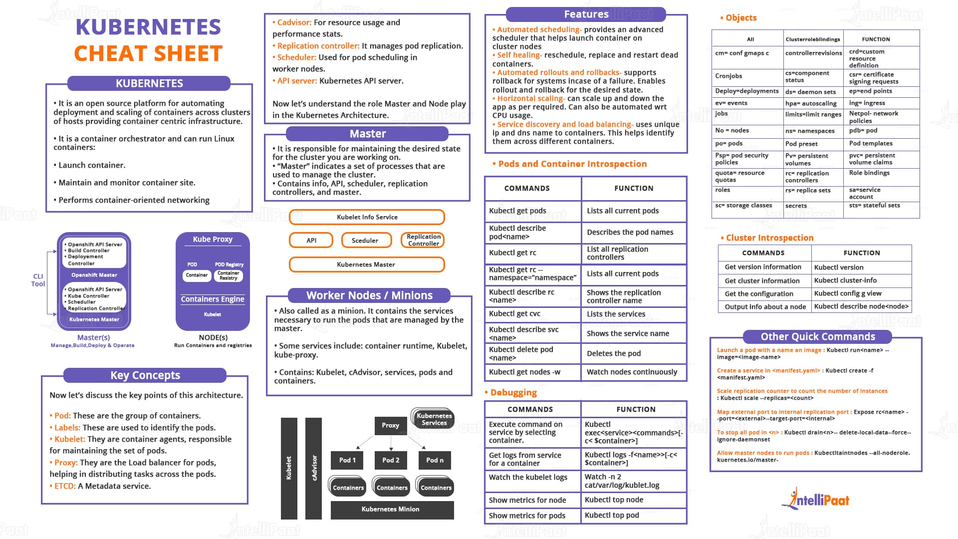
NOTE : Kubernetes Cheat Sheet

Slide 63
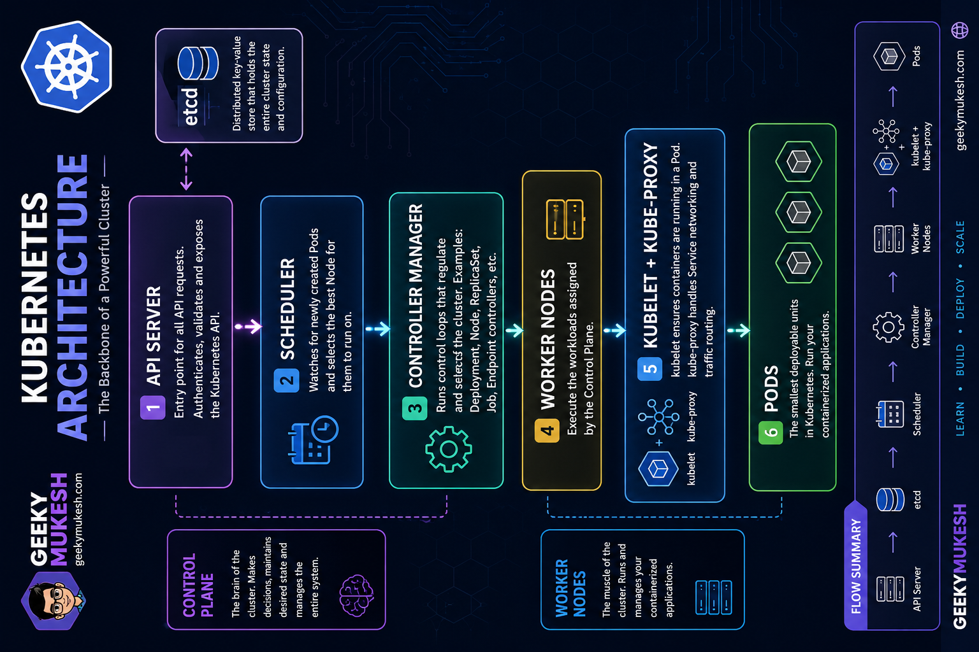
NOTE : Kubernetes Architecture

Slide 64

Reference
[1] Kubernetes in Action, Marko Luksa, Manning, 2018 1st Edition.
[2] https://github.com/luksa/kubernetes-in-action
[3] https://minikube.sigs.k8s.io/docs/
[4] https://kubernetes.io/docs/reference/kubectl/cheatsheet/

Slide 65

? & !

